Slide 1

R Stats
Amber and Anna

Slide 2
Correlations
Correlation between energy and danceability
Correlation between bpm and popularity
Correlation between popularity and energy
Notes:
data: spotify$popularity and spotify$energy t = -5.9247, df = 2383, p-value = 3.581e-09 alternative hypothesis: true correlation is not equal to 0 95 percent confidence interval: -0.1598484 -0.0807380 sample estimates: cor -0.1204845

Slide 3
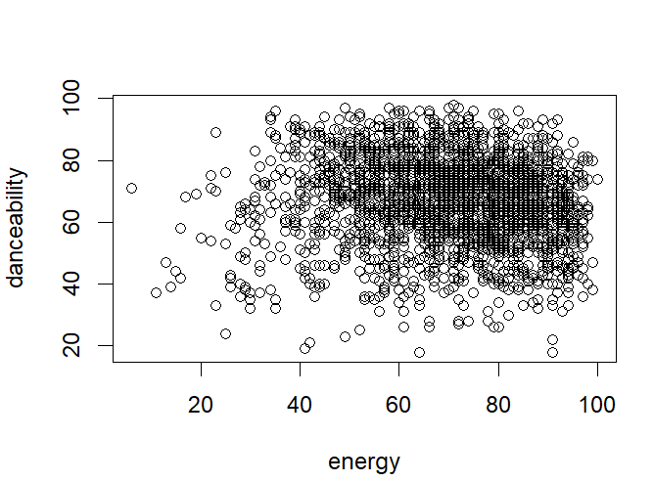
Correlations
plot(spotify$bpm, spotify$popularity,xlab="bpm", ylab="Popularity")
cor.test(spotify$bpm, spotify$popularity, method="pearson")
No correlation. p-value = 0.001201
Notes:
data: spotify$energy and spotify$danceability t = -3.2426, df = 2383, p-value = 0.001201 alternative hypothesis: true correlation is not equal to 0 95 percent confidence interval: -0.10613391 -0.02621218 sample estimates: cor -0.06627935

Slide 4
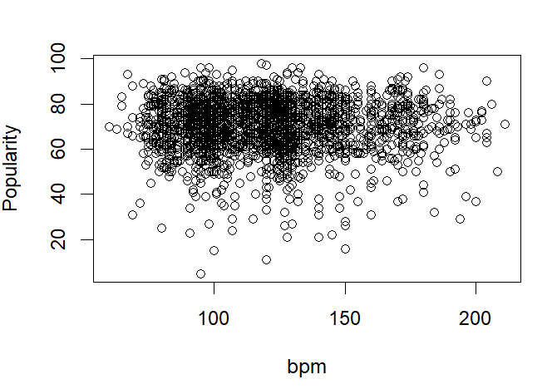
plot(spotify$energy, spotify$danceability,xlab="energy", ylab="danceability")
cor.test(spotify$energy, spotify$danceability, method="pearson")
No correlation. p-value = 0.3298
Notes:
data: spotify$bpm and spotify$popularity t = -0.97462, df = 2383, p-value = 0.3298 alternative hypothesis: true correlation is not equal to 0 95 percent confidence interval: -0.06005008 0.02019179 sample estimates: cor -0.01996129

Slide 5
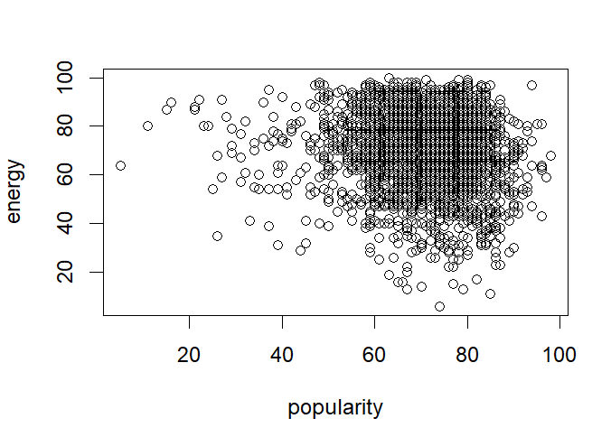
plot(spotify$popularity, spotify$energy,xlab="popularity", ylab="energy")
cor.test(spotify$popularity, spotify$energy, method="pearson")
Weak correlation. p-value = 3.581e-09
Notes:
data: spotify$popularity and spotify$energy t = -5.9247, df = 2383, p-value = 3.581e-09 alternative hypothesis: true correlation is not equal to 0 95 percent confidence interval: -0.1598484 -0.0807380 sample estimates: cor -0.1204845

Slide 6
Songs over time
Notes:
data: spotify$popularity and spotify$energy t = -5.9247, df = 2383, p-value = 3.581e-09 alternative hypothesis: true correlation is not equal to 0 95 percent confidence interval: -0.1598484 -0.0807380 sample estimates: cor -0.1204845

Slide 7
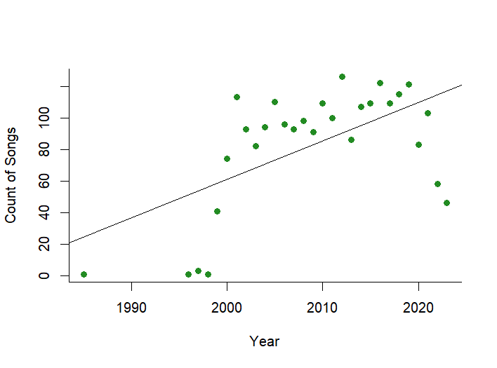
Songs over time
Least square linear regression indicates that as time goes on, the number of songs in the spotify best songs list increases (R²= 0.3415, t₂₇= 3.742, P< 0.001; Y= -4818.4 2.44X)
Notes:
data: spotify$popularity and spotify$energy t = -5.9247, df = 2383, p-value = 3.581e-09 alternative hypothesis: true correlation is not equal to 0 95 percent confidence interval: -0.1598484 -0.0807380 sample estimates: cor -0.1204845

Slide 8
Code for previous slide
spotify= read.csv("../datasets/Best Songs on Spotify from 2000-2023.csv", sep= ";")
View(spotify)
songtime <- as.data.frame(table(spotify$year))
songtime$Var1 <- as.numeric(as.character(songtime$Var1))
plot(songtime$Var1, songtime$Freq, xlab = "Year", ylab = "Count of Songs",pch=19,col="forestgreen",bty="l")
model <- lm(Freq ~ Var1, data = songtime)
abline(model)
summary(model)
Notes:
data: spotify$popularity and spotify$energy t = -5.9247, df = 2383, p-value = 3.581e-09 alternative hypothesis: true correlation is not equal to 0 95 percent confidence interval: -0.1598484 -0.0807380 sample estimates: cor -0.1204845

Slide 9
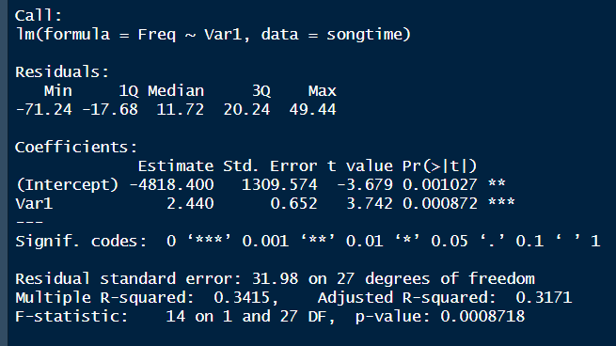
Output of stats test
Notes:
data: spotify$popularity and spotify$energy t = -5.9247, df = 2383, p-value = 3.581e-09 alternative hypothesis: true correlation is not equal to 0 95 percent confidence interval: -0.1598484 -0.0807380 sample estimates: cor -0.1204845

